Slide 1

A Small Company Network Design Project

Slide 2

Network Topology Overview
Network Topology Overview The network design includes multiple VLANs and regions, each connected via a central core switch, forming a robust small company network infrastructure. Below is a detailed breakdown of the network:

Slide 3
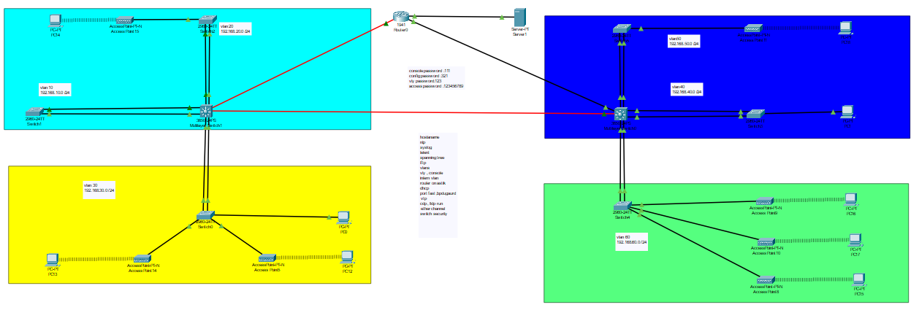
Network Design :
Components : Devices: Switches, Routers, PCs, and Servers.
Topology: Logical layout designed for optimal performance and scalability.

Slide 4

Configurations
Key Configurations Implemented:
Hostname Configuration
Time Synchronization: NTP Server
Logging System: Syslog Server
Access Management:
SSH
VTY and Console Access

Slide 5
VLAN and Routing
VLAN Configuration:
Segmentation of network into logical VLANs.
Inter-VLAN Routing:
Enabled via a Layer 3 device to facilitate communication.
Dynamic Host Configuration Protocol (DHCP):
Automates IP addressing for devices.

Slide 6

Spanning Tree and Port Features
Spanning Tree Protocol (STP):
Ensures a loop-free topology.
Port Enhancements:
PortFast: For faster network convergence.
BPDU Guard: Protection against rogue devices.

Slide 7

Management Protocols
VTP: VLAN Trunking Protocol to manage VLANs efficiently. CDP and LLDP: Device discovery and information sharing.
TFTP: Centralized server for file transfer.

Slide 8

Advanced Features
EtherChannel: Combines multiple physical links for increased bandwidth. Switch Security: Prevents unauthorized access and attacks.

Slide 9
OUR TEAM
Adham Emad Mohamed
Osama Ibrahim Mostafa
Ahmed Metwali Mohamed
Abdelrahman Atta Ibrahim

Slide 10

THANK YOU

